Slide 1

SQL Group 4 Project - Instacart
MS Information Science

Slide 2
Contents
MS Information Science
1.
Meet the Team
2.
Project Roadmap
3.
Introduction
4.
Database Design Overview
5.
SQL Queries
6.
Results

Slide 3
Meet the team
Sharad Talekar
MS Information Science
Avi Kumar Talaviya
MS Information Science
Ayesha Siddiqua Guffran
MS Information Science
Prathamesh Deshpande
MS Information Science
Ankur Singh
MS Information Science

Slide 4
Project roadmap
Step 1
Step 2
Step 3
Step 4
Goal
Introduction
Database Design Overview
SQL Queries
Results
Conclusion

Slide 5
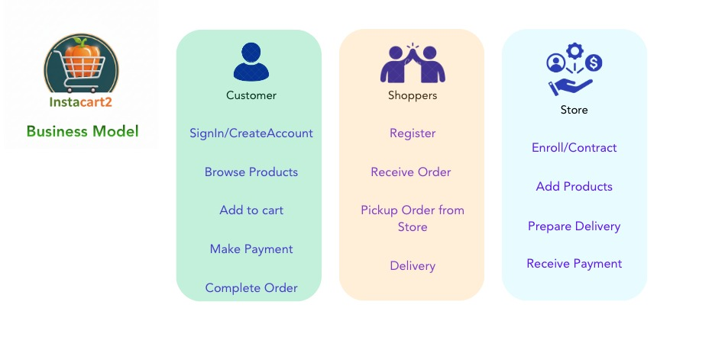
Project roadmap
Step 2
Step 3
Step 4
Goal
Step 1
Introduction
Instacart operates on a three-sided marketplace involving Customers, Shoppers, and Stores.
Customers browse products, add items to cart, and place orders.
Shoppers pick items from the store and deliver them. Stores manage product availability, inventory, and pricing.
Database Design Overview
SQL Queries
Results
Conclusion

Slide 6
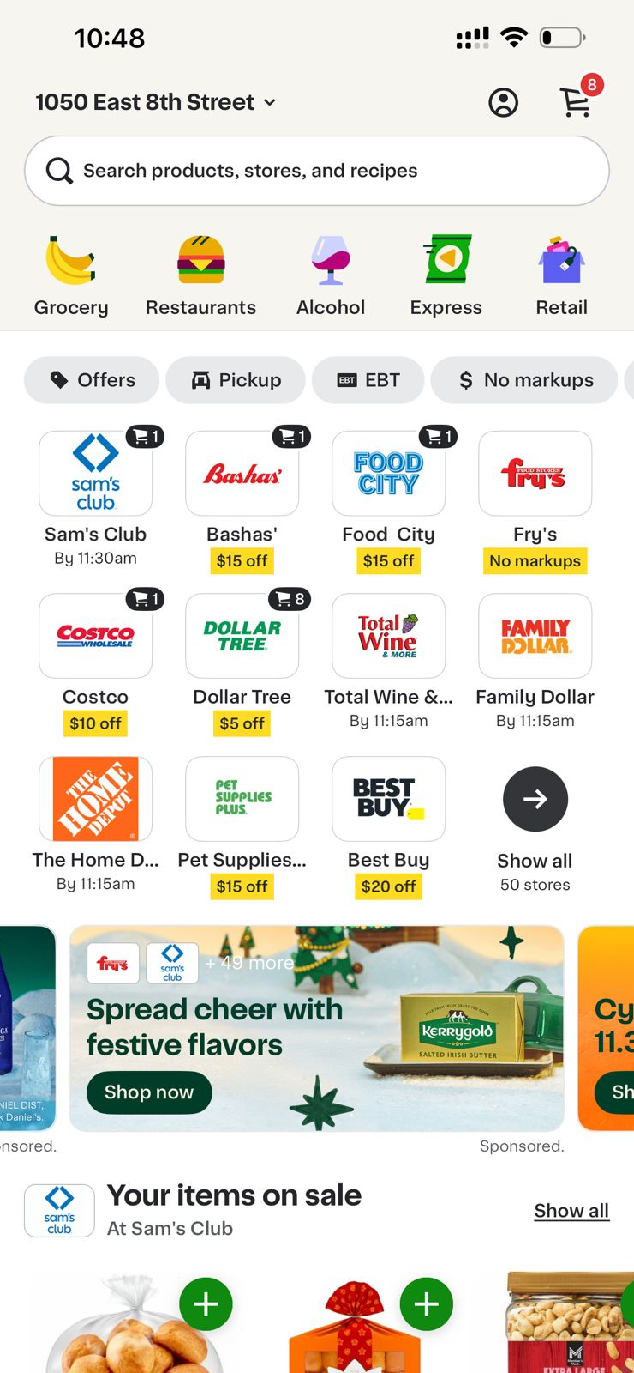
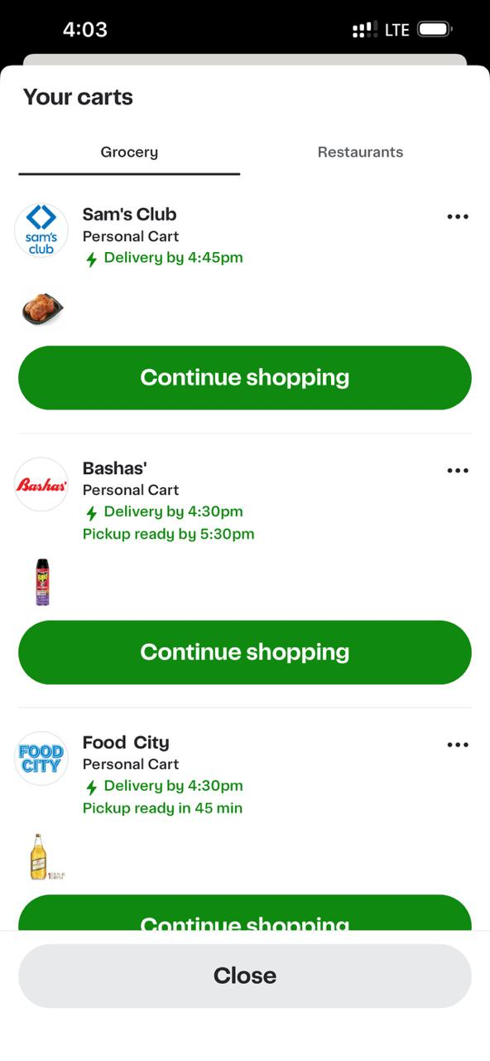

Slide 7
Project roadmap
Step 1
Step 2
Step 3
Step 4
Goal
Our goal was to design a simplified version of Instacart’s database and run SQL queries to analyze patterns in orders, customers, and products.
The main objective was to apply SQL concepts to a realistic dataset structure.
We’ll start with the database design, then show our SQL queries, and finally discuss our results.
Understanding how Instacart structures its data is useful because similar systems are used across e-commerce, grocery delivery, and logistics platforms.
We used MySQL Workbench to design our schema and run our queries.
Introduction
Database Design Overview
SQL Queries
Results
Conclusion

Slide 8
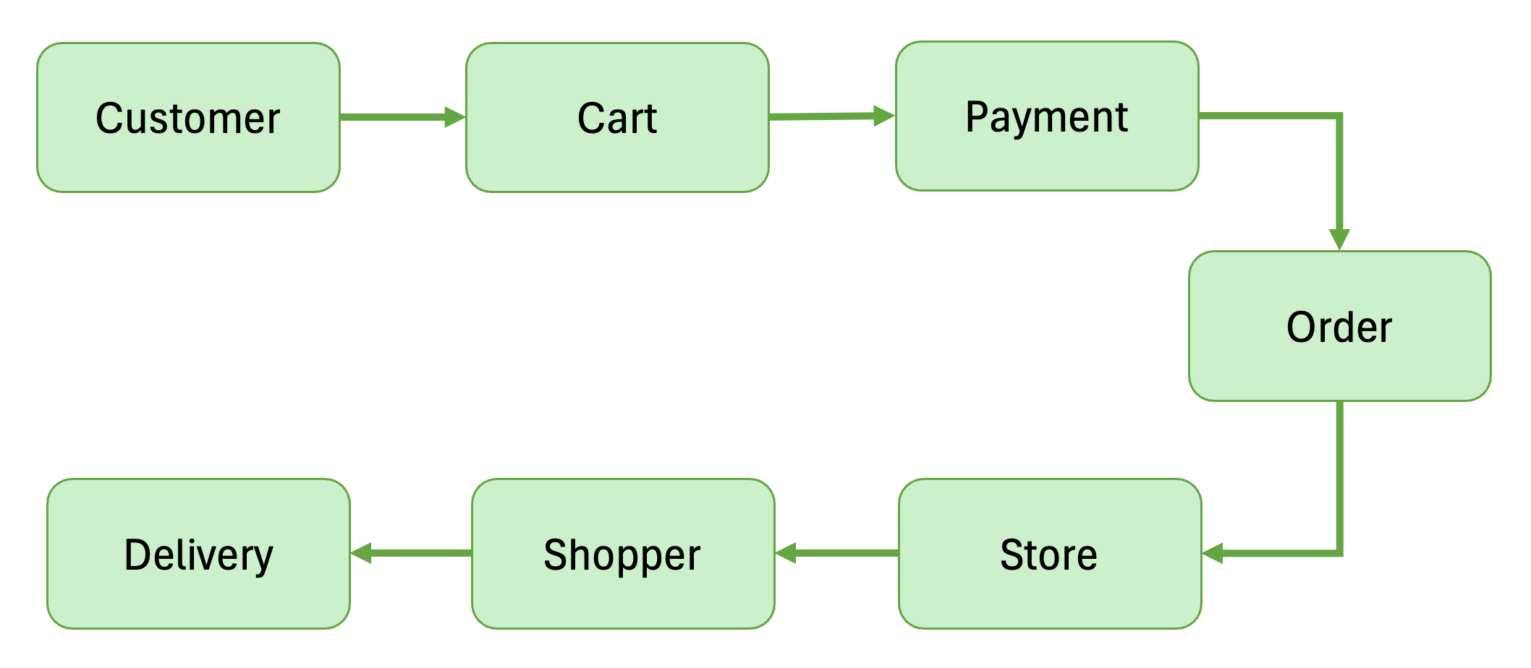
Project roadmap
Step 1
Step 2
Step 3
Step 4
Goal
Database Design Overview
Process Flow Diagram
Conclusion
Results
SQL Queries
Introduction

Slide 9
Project roadmap
Step 1
Step 2
Step 3
Step 4
Goal
Database Design Overview
Themes:
Customer Theme – Captures customer-related information such as name, email, phone, and profile details.
Product Theme – Stores product-level information including name, description, price, and assigned category.
Order Theme – Represents customer orders and the essential details associated with each purchase.
Order Item Theme – Breaks down each order into individual items and quantities, linking products to orders.
Category Theme – Organizes products into logical groups for better classification and filtering.
Cart Theme – Tracks items a customer selects before completing an order (shopping cart state).
Payment Theme – Records payment method, amount, and status associated with each order.
Address Theme – Stores address information for both customers and stores to support delivery and location mapping.
Conclusion
Results
SQL Queries
Introduction

Slide 10
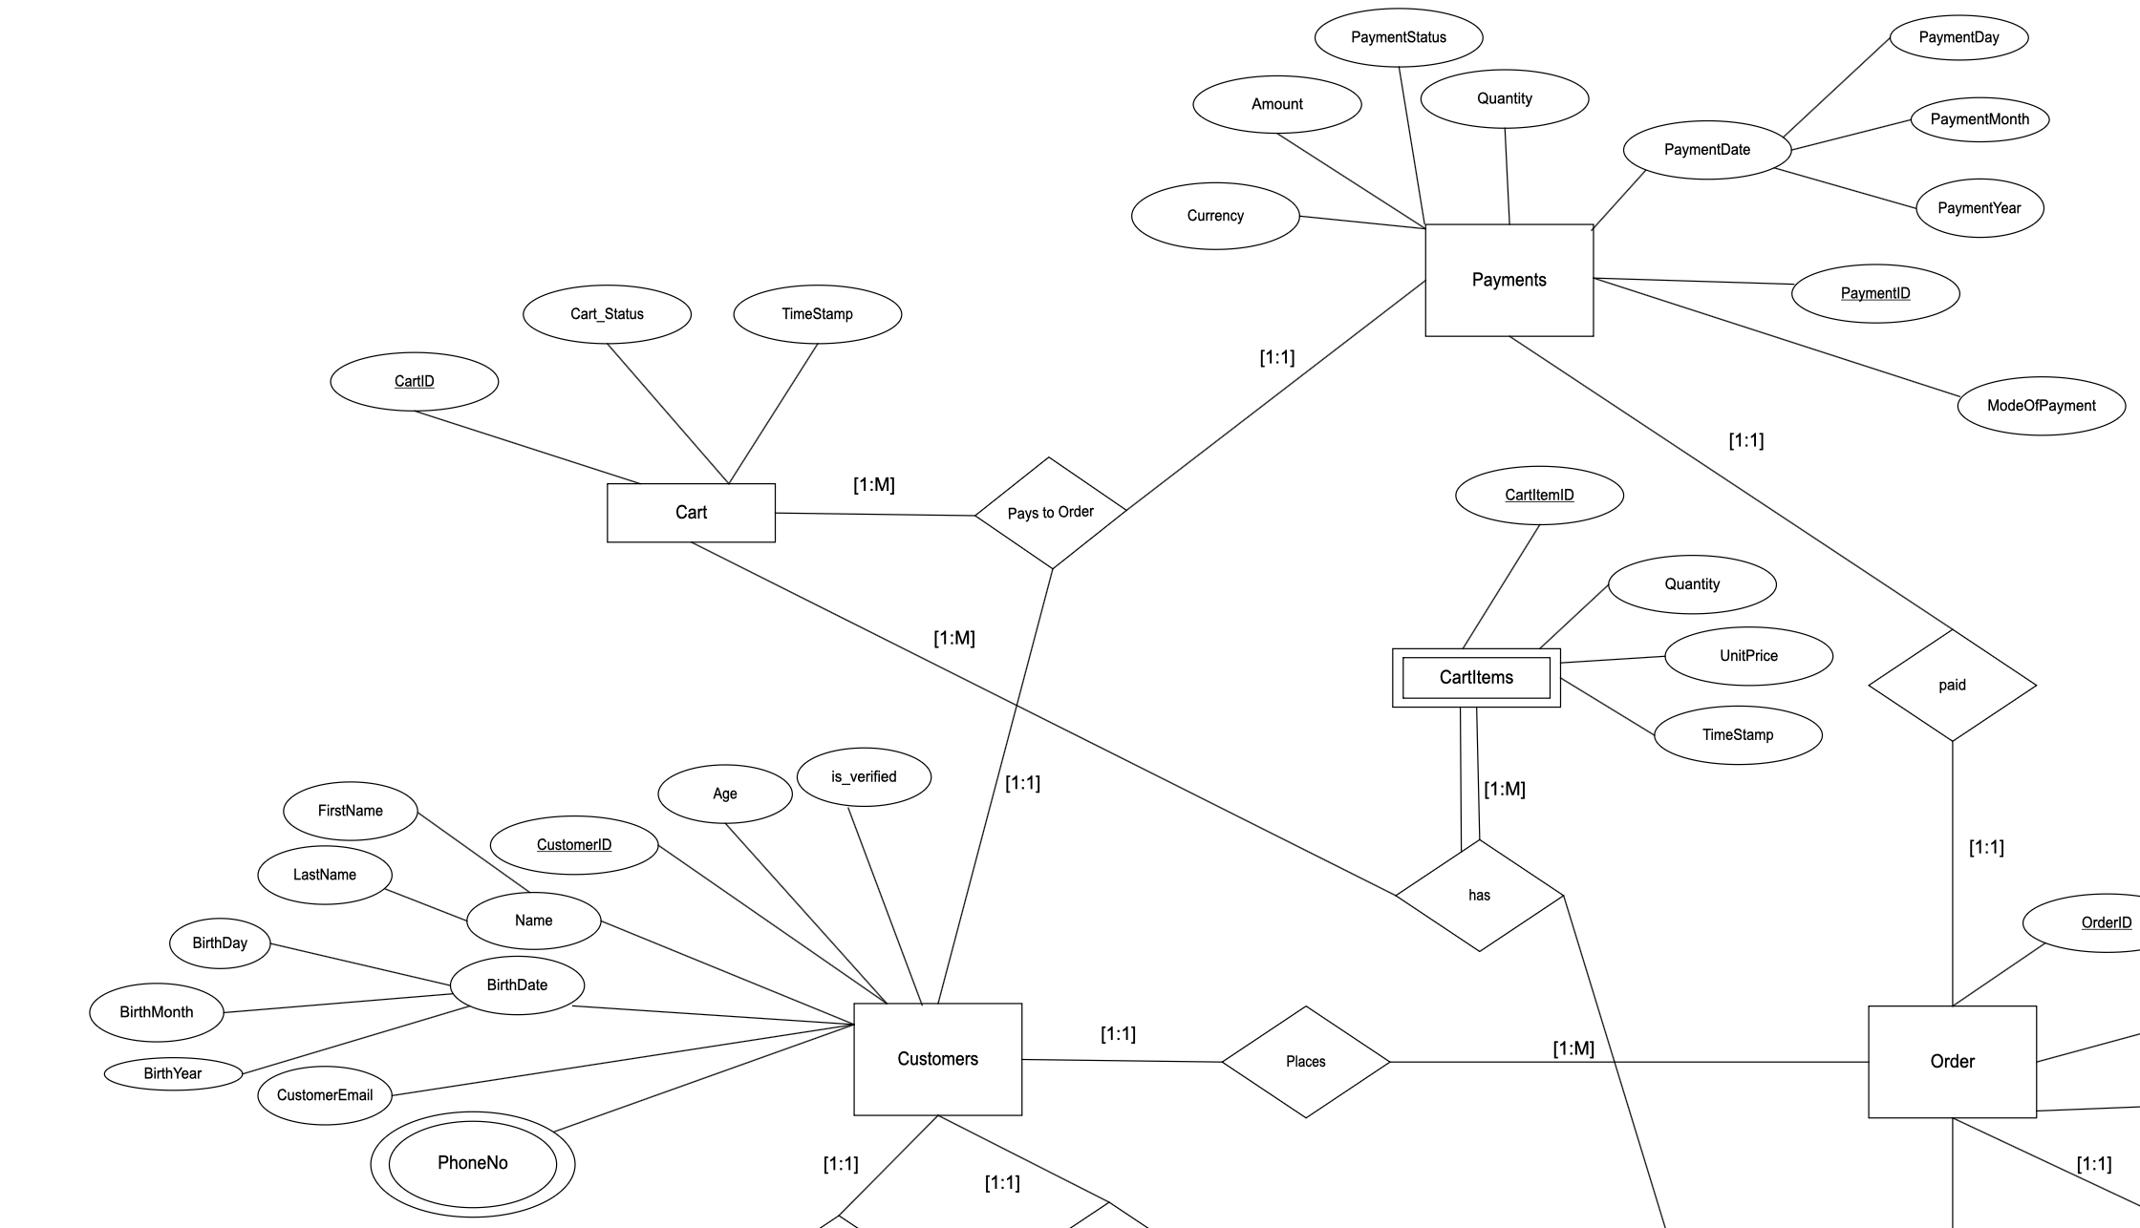
Project roadmap
Step 1
Step 2
Step 3
Step 4
Goal
Database Design Overview
Conclusion
Results
SQL Queries
Introduction

Slide 11
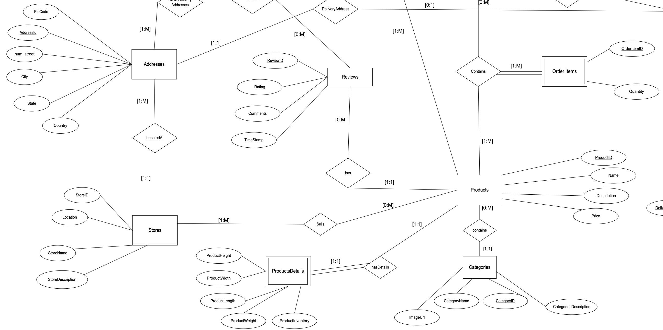
Project roadmap
Step 1
Step 2
Step 3
Step 4
Goal
Database Design Overview
Conclusion
Results
SQL Queries
Introduction

Slide 12
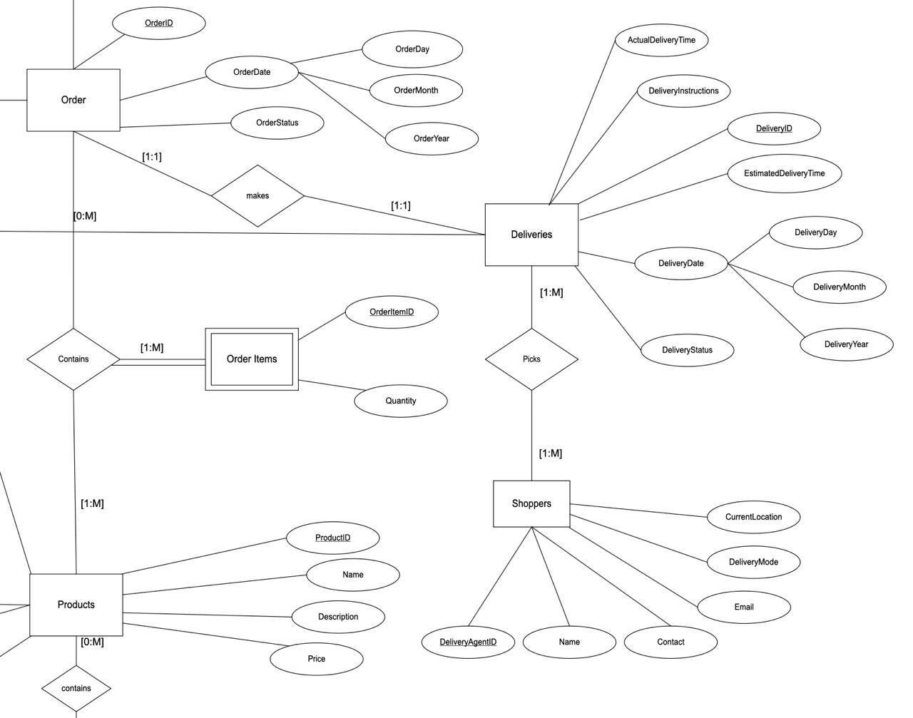
Project roadmap
Step 1
Step 2
Step 3
Step 4
Goal
Database Design Overview
Conclusion
Results
SQL Queries
Introduction

Slide 13
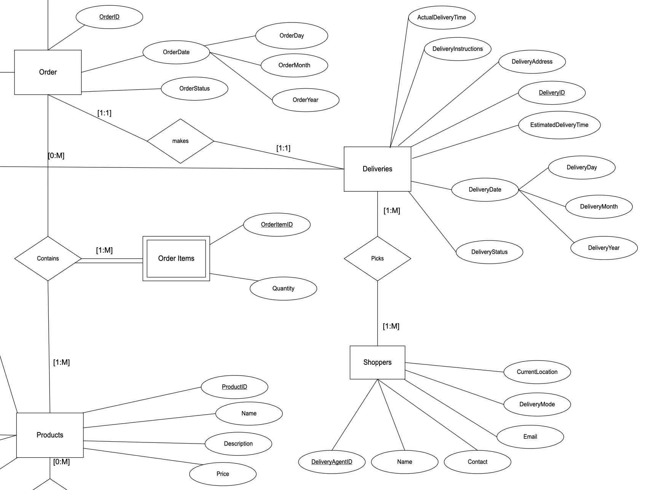
Project roadmap
Step 1
Step 2
Step 3
Step 4
Goal
Database Design Overview
SQL Queries
Results
Conclusion
Introduction

Slide 14
Some Question we thought and will answer via queries
Query 1: Show the Store details for each product sold
Query 2: Get a list of cities covered by operations of instacart2 based on customer and store locations
Query 3: Find the Order with highest total amount
Query 4: Find customers who have never created a cart (for further marketing targets)
Query 5: List all Customers with reviews

Slide 15
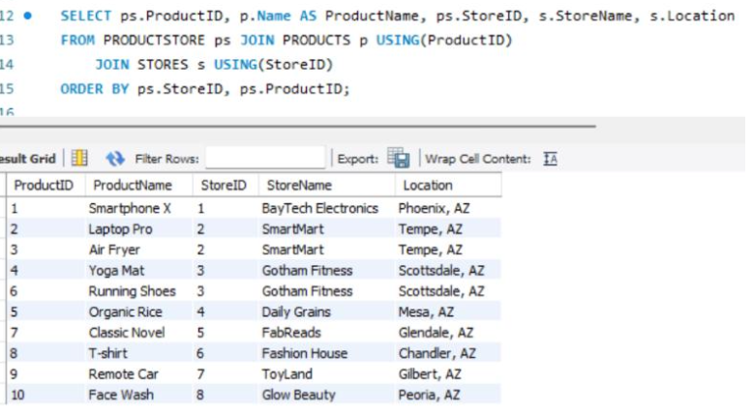
Project roadmap
Step 1
Step 2
Step 3
Step 4
Goal
SQL Queries
Query 1: Show the Store details for each product sold
SELECT ps.ProductID, p.Name AS ProductName, ps.StoreID, s.StoreName, s.Location
FROM PRODUCTSTORE ps JOIN PRODUCTS p USING(ProductID)
JOIN STORES s USING(StoreID)
ORDER BY ps.StoreID, ps.ProductID;
This query uses multi-table INNER JOINs to show which products are available in which stores. By joining the PRODUCTSTORE, PRODUCTS, and STORES tables, we can view product names, store names, and store locations in one combined result. The final output is ordered by store and product for clarity.
Introduction
Database Design Overview
Conclusion
Results

Slide 16
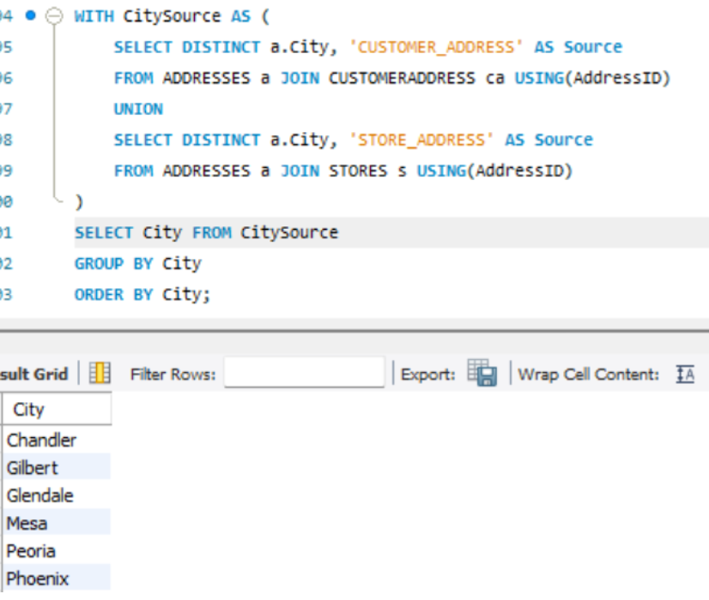
Project roadmap
Step 1
Step 2
Step 3
Step 4
Goal
SQL Queries
Query 2: Get a list of cities covered by operations of instacart2 based on
customer and store locations
WITH CitySource AS (
SELECT DISTINCT a.City, 'CUSTOMER_ADDRESS' AS Source
FROM ADDRESSES a JOIN CUSTOMERADDRESS ca USING(AddressID)
UNION
SELECT DISTINCT a.City, 'STORE_ADDRESS' AS Source
FROM ADDRESSES a JOIN STORES s USING(AddressID)
)
SELECT City FROM CitySource
GROUP BY City
ORDER BY City;
This query gives us a single combined list of all cities where customers live or stores are located. It merges cities from both customer addresses and store addresses and removes duplicates, showing every unique city in our database
Introduction
Database Design
Overview
Results
Conclusion

Slide 17
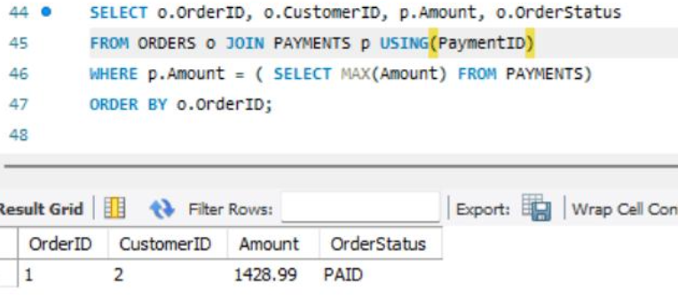
Project roadmap
Step 1
Step 2
Step 3
Step 4
Goal
SQL Queries
Query 3: Find the Order with highest total amount
SELECT o.OrderID, o.CustomerID, p.Amount, o.OrderStatus
FROM ORDERS o JOIN PAYMENTS p USING(PaymentID)
WHERE p.Amount = ( SELECT MAX(Amount) FROM PAYMENTS)
ORDER BY o.OrderID;
This query uses a JOIN along with a single-row subquery. The subquery returns the maximum payment amount from the PAYMENTS table, and the main query retrieves the order(s) that match this amount. Because MAX() produces only one value, the subquery is a single-row subquery.
Introduction
Database Design
Overview
Results
Conclusion

Slide 18
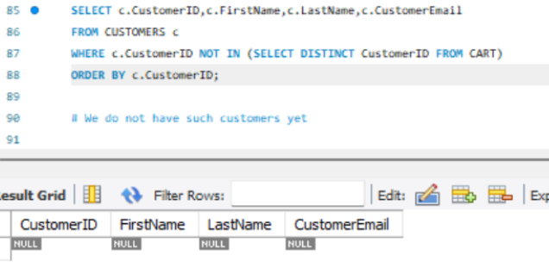
Project roadmap
Step 1
Step 2
Step 3
Step 4
Goal
SQL Queries
Query 4: Find customers who have never created
a cart (for further marketing targets)
SELECT c.CustomerID,c.FirstName,c.LastName,c.CustomerEmail
FROM CUSTOMERS c
WHERE c.CustomerID NOT IN (SELECT DISTINCT CustomerID FROM CART)
ORDER BY c.CustomerID;
This query identifies customers who have never added items to a cart. It uses a NOT IN subquery to compare CustomerIDs in the CUSTOMERS table with those in the CART table. Customers missing from the CART table are returned as results.
Introduction
Database Design
Overview
Results
Conclusion

Slide 19
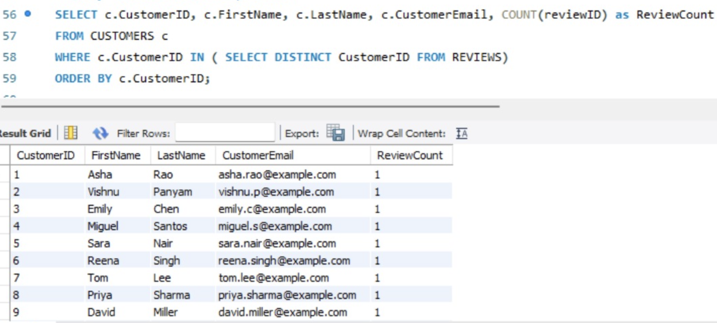
Project roadmap
Step 1
Step 3
Step 4
Step 2
Goal
SQL Queries
Query 5: List all Customers with reviews
SELECT c.CustomerID, c.FirstName, c.LastName, c.CustomerEmail, COUNT(r.ReviewID) AS ReviewCount
FROM CUSTOMERS c
JOIN REVIEWS r ON c.CustomerID = r.CustomerID
GROUP BY c.CustomerID, c.FirstName, c.LastName, c.CustomerEmail
ORDER BY c.CustomerID;
This query identifies all customers who have written reviews. It uses an IN subquery to find CustomerIDs present in the REVIEWS table and returns their details from the CUSTOMERS table. The subquery returns multiple rows, so this is a multiple-row subquery.
Introduction
Database Design
Overview
Results
Conclusion

Slide 20
Project roadmap
Step 1
Step 2
Step 3
Step 4
Goal
SELECT c.CustomerID, c.FirstName, c.LastName, c.CustomerEmail, COUNT(r.ReviewID) AS ReviewCount
FROM CUSTOMERS c
JOIN REVIEWS r ON c.CustomerID = r.CustomerID
GROUP BY c.CustomerID, c.FirstName, c.LastName, c.CustomerEmail
ORDER BY c.CustomerID;
This query identifies all customers who have written reviews. It uses an IN subquery to find CustomerIDs present in the REVIEWS table and returns their details from the CUSTOMERS table. The subquery returns multiple rows, so this is a multiple-row subquery.
Introduction
Database Design
Overview
SQL Queries
Results
Conclusion

Slide 21
Project roadmap
Step 1
Step 3
Step 2
Step 4
Goal
Results
Results and Insights:
Identified store locations and customer locations using city data extracted from both customer and store address tables.
Found the highest-value order by selecting the transaction with the maximum payment amount.
Detected customers who have never created a cart, helping highlight inactive or low-engagement users.
Calculated how many reviews each customer submitted, showing which users are most active in providing feedback.
Overall, the query results confirm that our database design supports meaningful analysis of customer activity, payments, and geographic coverage.
SQL Queries
Introduction
Conclusion
Database Design
Overview

Slide 22
Project roadmap
Step 1
Step 2
Step 3
Step 4
Goal
Results and Insights:
Identified which products are sold in each store, along with store names and locations.
Retrieved the highest-value order based on the maximum payment amount.
Found customers who have never created a cart, indicating low engagement.
Counted how many reviews each customer submitted to measure review activity.
Added a normalized PhoneNumber table to support clean and scalable customer data.
Introduction
Database Design
Overview
SQL Queries
Results
Conclusion

Slide 23
Project roadmap
Step 1
Step 2
Step 3
Step 4
Goal
Conclusion
Results and Insights:
Identified which products are sold in each store, along with store names and locations.
Retrieved the highest-value order based on the maximum payment amount.
Found customers who have never created a cart, indicating low engagement.
Counted how many reviews each customer submitted to measure review activity.
Added a normalized PhoneNumber table to support clean and scalable customer data.
We built a fully normalized relational database that mimics Instacart’s workflow, from cart creation to payment and delivery. Through our ER diagram, table design, and SQL queries, we demonstrated that the schema imitates real-world operations and supports meaningful analytical insights. This project strengthened our technical skills and our ability to model realistic business systems.
Key Takeaways:
ER diagram clearly captured the major entities and their relationships.
Normalized tables ensured clean, efficient, and reliable data structure.
SQL queries validated data integrity and uncovered useful patterns.
Enhanced our skills in database design, SQL querying, and modeling real-world workflows.
Introduction
Database Design
Overview
SQL Queries
Results

Slide 24
Any questions?
Ask away!

Slide 25
Thank you

